Slide 1

Advanced Java Programming
Topic: File I/O (NIO.2)
By
Ravi Kant Sahu
Asst. Professor, LPU

Slide 2
Contents…
Using the Path interface to operate on file and directory paths
Using the Files class to check, delete, copy, or move a file or directory
Using Stream API with NIO2
Ravi Kant Sahu, Asst. Professor @ Lovely Professional University, Punjab (India)

Slide 3
Introduction
NIO API in JSR51 established the basis for NIO in Java focusing on buffers, channels and charsets.
The java.nio.file package and its related package, java.nio.file.attribute, provide comprehensive support for file I/O and for accessing the default file system.
JSR: Java Specification Request
Ravi Kant Sahu, Asst. Professor @ Lovely Professional University, Punjab (India)

Slide 4
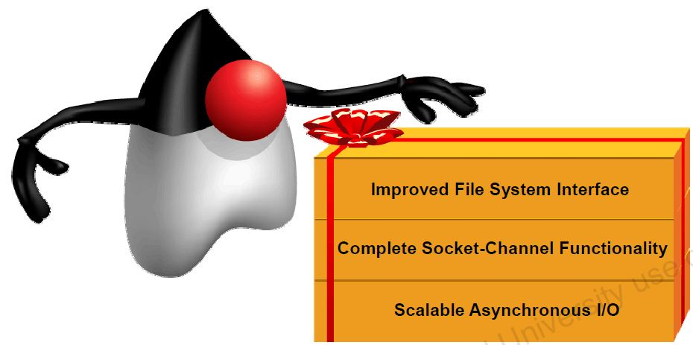
NIO.2
Ravi Kant Sahu, Asst. Professor @ Lovely Professional University, Punjab (India)

Slide 5
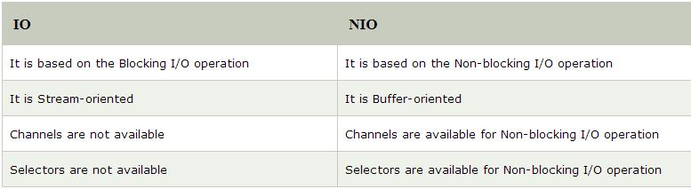
Java IO Vs NIO
Ravi Kant Sahu, Asst. Professor @ Lovely Professional University, Punjab (India)

Slide 6
New File I/O API
Works more consistently across platforms and provides more efficient access to a larger set of file attributes.
Makes it easier to write programs that gracefully handle the failure of file system operation.
Allows support for non-native file systems, to be “plugged in” to the platform
Allows developers of sophisticated applications to take advantage of platform specific features when absolutely necessary.
Ravi Kant Sahu, Asst. Professor @ Lovely Professional University, Punjab (India)

Slide 7
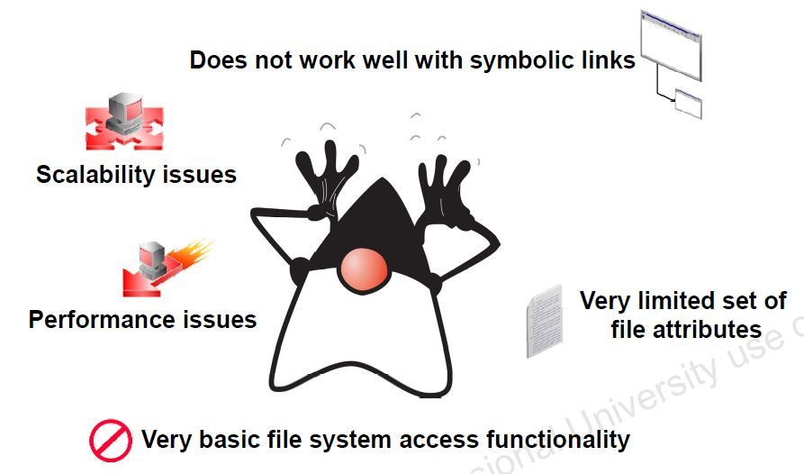
Limitations of java.io.File
Ravi Kant Sahu, Asst. Professor @ Lovely Professional University, Punjab (India)

Slide 8
Limitations of java.io.File
Many methods did not throw exceptions when they failed
Several operations were missing (File copy, move etc)
rename() did not work consistently across platforms.
No real support for symbolic links
More support for metadata was desired such as file permissions, owner etc
Ravi Kant Sahu, Asst. Professor @ Lovely Professional University, Punjab (India)

Slide 9
Limitations of java.io.File
Accessing file metadata was inefficient, every call for metadata resulted in a system call, which made it very inefficient.
Many of the file methods did not scale, requesting a large directory listing on a server could result in a hang.
It was not possible to write reliable code that could recursively walk a file tree and respond appropriately if there were circular symbolic links.
Ravi Kant Sahu, Asst. Professor @ Lovely Professional University, Punjab (India)

Slide 10
File systems, paths, files
Ravi Kant Sahu, Asst. Professor @ Lovely Professional University, Punjab (India)

Slide 11
File System and Path
In NIO2, both files and directory are represented by a path, which is relative or absolute location of the file or directory.
Prior to NIO.2, files were represented by the java.io.File class.
In NIO.2, java.nio.file.Path object is used to represent the relative or absolute location of a file or directory.
Ravi Kant Sahu, Asst. Professor @ Lovely Professional University, Punjab (India)

Slide 12
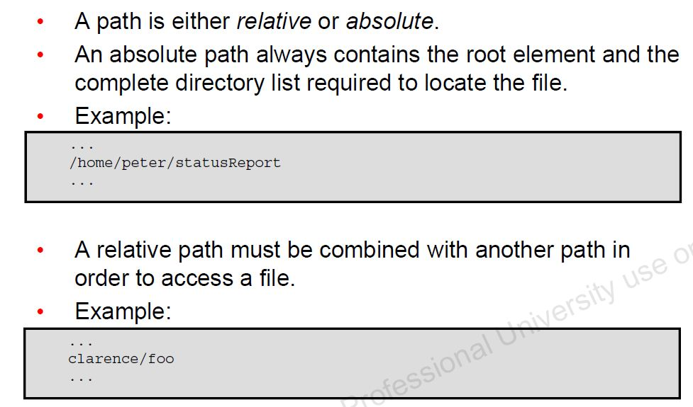
Relative Path Vs Absolute Path
Ravi Kant Sahu, Asst. Professor @ Lovely Professional University, Punjab (India)

Slide 13
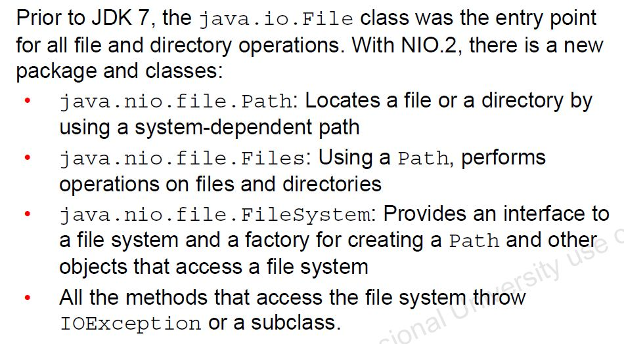
Java NIO.2 Concepts
Ravi Kant Sahu, Asst. Professor @ Lovely Professional University, Punjab (India)

Slide 14
Path Interface
To create a Path object we can use the get method of the Paths class like this:
Path p1 = Paths.get("c:\\file.txt");
// using an absolute path
Path p2 = Paths.get("c:\\data", "examples\\file.txt");
// using a relative path to construct the path
Ravi Kant Sahu, Asst. Professor @ Lovely Professional University, Punjab (India)

Slide 15
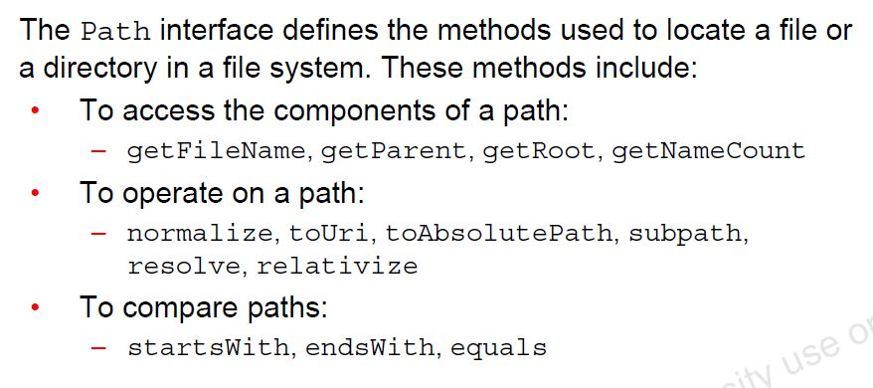
Features of Path Interface
Ravi Kant Sahu, Asst. Professor @ Lovely Professional University, Punjab (India)

Slide 16
Methods of Path Interface
FileSystem getFileSystem()
Path getFileName()
Path getParent()
Path getRoot()
boolean isAbsolute()
Path toAbsolutePath()
URI toUri()
NOTE: The Path object can be created for any path. The actual file/directory need not exist.
Ravi Kant Sahu, Asst. Professor @ Lovely Professional University, Punjab (India)

Slide 17
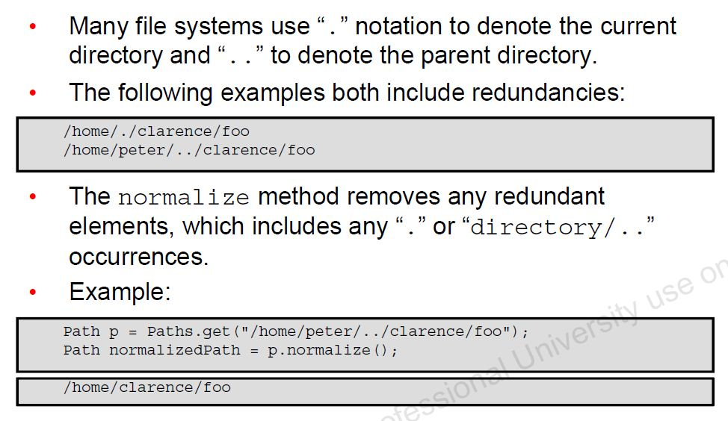
Removing Redundancies from a Path
Ravi Kant Sahu, Asst. Professor @ Lovely Professional University, Punjab (India)

Slide 18
Example
Path path = Paths.get("c:\\users\\admin\\file.txt");
Path path = path.getFileName(); // returns file.txt
Path path = path.getName(0); // returns users
int count = path.getNameCount(); // returns 3 (users, admin and file.txt)
Path path = path.subpath(0, 2); // returns users/admin
Path path = path.getParent(); // returns /users/admin
Path path = path.getRoot(); // returns c:\ (if we were in a unix filesystem, it would return /)
Ravi Kant Sahu, Asst. Professor @ Lovely Professional University, Punjab (India)

Slide 19
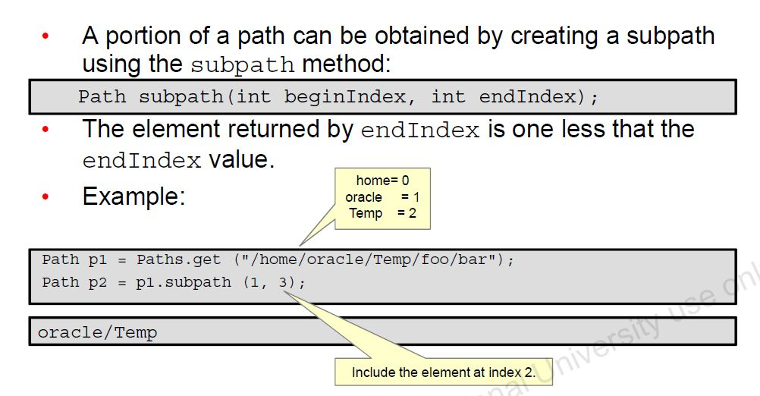
Creating subpath
Ravi Kant Sahu, Asst. Professor @ Lovely Professional University, Punjab (India)

Slide 20
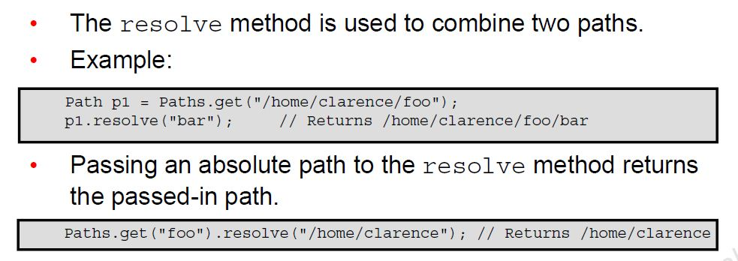
Joining two Paths
Ravi Kant Sahu, Asst. Professor @ Lovely Professional University, Punjab (India)

Slide 21
Converting Path to File and File to Path
File f = Paths.get("file.txt").toFile();
Path p = new File("file.txt").toPath();
Ravi Kant Sahu, Asst. Professor @ Lovely Professional University, Punjab (India)

Slide 22
files Class
Ravi Kant Sahu, Asst. Professor @ Lovely Professional University, Punjab (India)

Slide 23
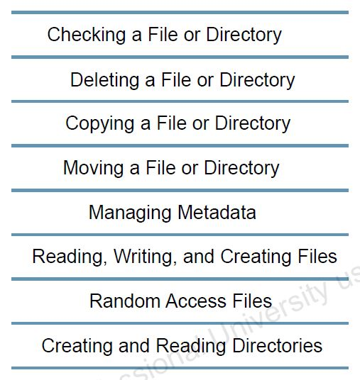
Files Class
java.nio.file.Files class contains static methods that operate on files and directories.
Ravi Kant Sahu, Asst. Professor @ Lovely Professional University, Punjab (India)

Slide 24
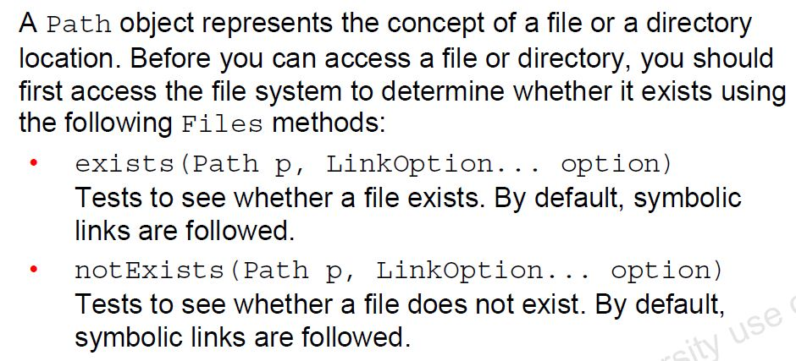
Checking a File or Directory?
Ravi Kant Sahu, Asst. Professor @ Lovely Professional University, Punjab (India)

Slide 25
Example
Path p = Paths.get("d:/java/pack/Student.java");
System.out.println("Exists?: "+ Files.exists(p));
System.out.println("Exists?: "+ Files.exists(p,
LinkOption.NOFOLLOW_LINKS));
System.out.println("Not Exists?: "+ Files.notExists(p));
System.out.println("Not Exists?: "+ Files.notExists
(p, LinkOption.NOFOLLOW_LINKS));
NOTE: !Files.exists(p) is not equivalent to Files.notExists(p).
If both returns FALSE, the existence file or directory can not be determined.
LinkOption is an enum.
Ravi Kant Sahu, Asst. Professor @ Lovely Professional University, Punjab (India)

Slide 26
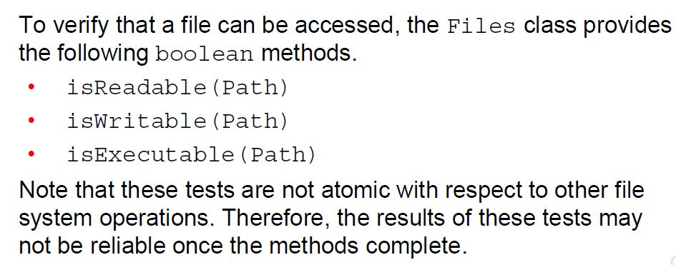
Checking a File or Directory?
Ravi Kant Sahu, Asst. Professor @ Lovely Professional University, Punjab (India)

Slide 27
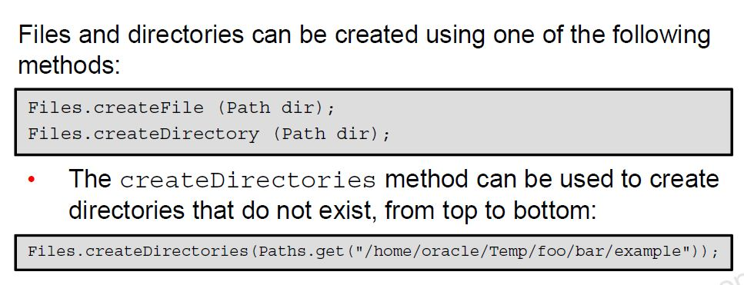
Creating Files and Directories
Ravi Kant Sahu, Asst. Professor @ Lovely Professional University, Punjab (India)

Slide 28
Let’s Do Something…
What will happen If You:
Use createFile() and the directory for that File does not exist?
Use createFile() and the File already exist?
Use createDirectory() and the directory already exist?
Use createDirectory() and the parent directory does not exist?
Ravi Kant Sahu, Asst. Professor @ Lovely Professional University, Punjab (India)

Slide 29
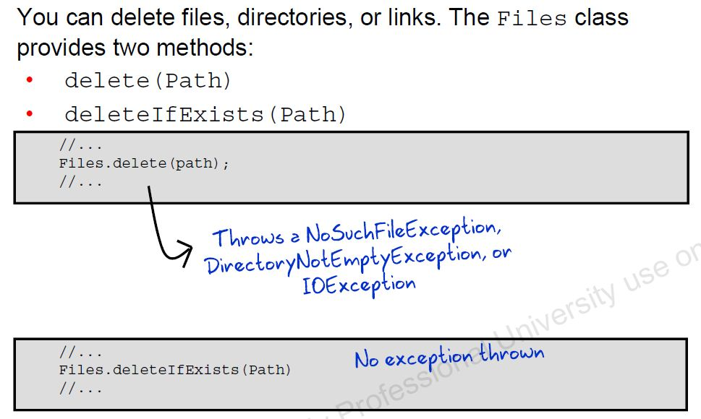
Deleting a File or Directory
Ravi Kant Sahu, Asst. Professor @ Lovely Professional University, Punjab (India)

Slide 30
Copying a File
The Files.copy() method copies a file from one path to another.
If the destination file already exists, java.nio.file.FileAlreadyExistsException is thrown.
Path src = Paths.get("file.txt");
Path tar = Paths.get("file-copy.txt");
try { Files.copy(src, tar); }
catch(Exception e) {e.printStackTrace(); }
If you want to overwrite an existing file use this line:
Files.copy(src, tar, StandardCopyOption.REPLACE_EXISTING);
Ravi Kant Sahu, Asst. Professor @ Lovely Professional University, Punjab (India)

Slide 31
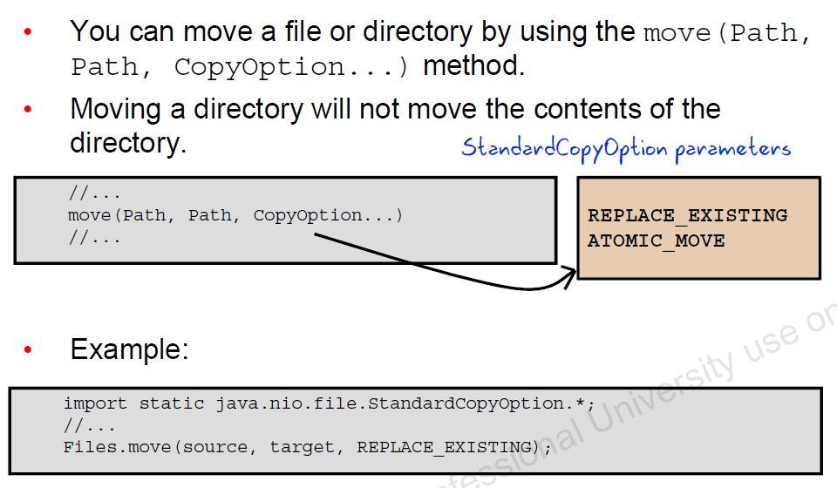
Moving a File
Ravi Kant Sahu, Asst. Professor @ Lovely Professional University, Punjab (India)

Slide 32
Managing Metadata
The following methods can be used to extract information about the file or directory:
public static boolean isReadable(Path path)
public static boolean isWritable(Path path)
public static boolean isExecutable(Path path)
public static boolean isDirectory(Path path, LinkOption... options)
public static boolean isHidden(Path path)
public static long size(Path path) Returns the size of a file (in bytes).
Ravi Kant Sahu, Asst. Professor @ Lovely Professional University, Punjab (India)

Slide 33
Stream API with NIO.2
Ravi Kant Sahu, Asst. Professor @ Lovely Professional University, Punjab (India)

Slide 34
Using list() method
public static Stream<Path> list(Path dir)
Streams all the elements of a given directory.
Stream<Path> stream = Files.list(Paths.get(“g:\\Java"))
stream.map(String::valueOf) .filter(path -> path.endsWith(".txt")) .forEach(System.out::println);
Ravi Kant Sahu, Asst. Professor @ Lovely Professional University, Punjab (India)

Slide 35
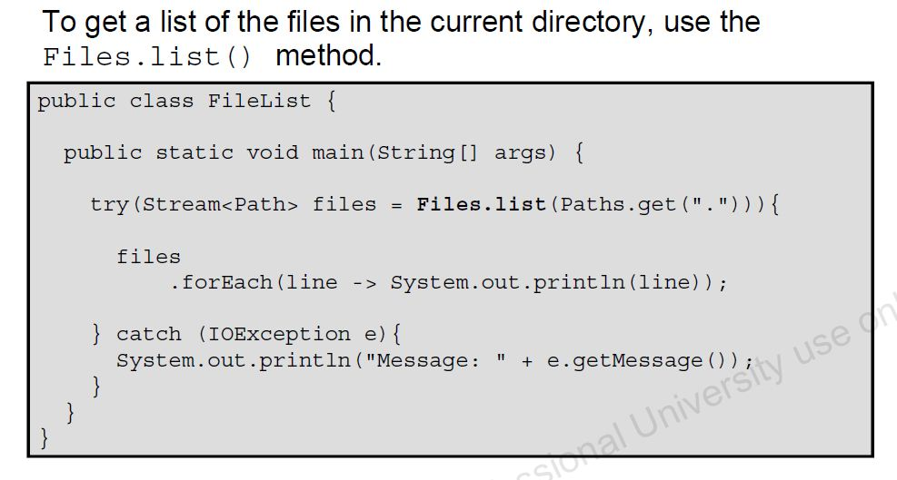
List the contents of a Directory
Ravi Kant Sahu, Asst. Professor @ Lovely Professional University, Punjab (India)

Slide 36
Exercise
Write a Program which prompts the user to enter the path. Now display the names of all the .java files which are present in that path.
Write a program to delete all the empty sub-directrories which are present is a particular path.
Ravi Kant Sahu, Asst. Professor @ Lovely Professional University, Punjab (India)

Slide 37
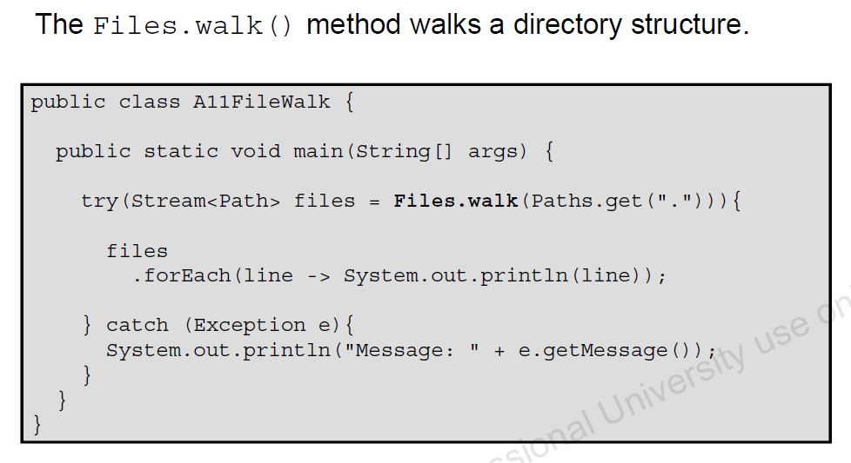
Walk the Directory Structure
Ravi Kant Sahu, Asst. Professor @ Lovely Professional University, Punjab (India)

Slide 38
Read Lines and BufferedReader
public static Stream<String> lines(Path path, Charset cs)
public static Stream<String> lines(Path path) // Uses the UTF-8 charset.
This method reads all lines from a file into a stream.
Stream<String> stream = Files.lines(Paths.get("c:\\data\\file.txt")) stream.map(String::toLowerCase).forEach(System.out::println);
Ravi Kant Sahu, Asst. Professor @ Lovely Professional University, Punjab (India)

Slide 39
Read Lines and BufferedReader
Buffered Reader also supports stream with its lines method:
BufferedReader reader = Files.newBufferedReader(Paths.get("c:\\data\files.txt")) ; reader.lines().map(String::toLowerCase).forEach(System.out::println);
Ravi Kant Sahu, Asst. Professor @ Lovely Professional University, Punjab (India)

Slide 40


